Slide 1
Welcome!
Please silence your devices

Slide 2
Board of Directors Meeting
June 6, 2014

Slide 3
June 6, 2014 Board of Directors Meeting
Call to Order /
Pledge of Allegiance

Slide 4
June 6, 2014 Board of Directors Meeting

Slide 5
June 6, 2014 Board of Directors Meeting
Antitrust Policy

Slide 6
June 6, 2014 Board of Directors Meeting
Introductions

Slide 7
June 6, 2014 Board of Directors Meeting
Remonstrances

Slide 8
June 6, 2014 Board of Directors Meeting
Roll Call

Slide 9
June 6, 2014 Board of Directors Meeting
Consent Agenda
Approve Board Minutes: April 18, 2014
Chapter Financial Report: through April 2014
Membership Report: April–May
Ratification of Foundation Actions
Trustee Appointment to the AGC–International Union of Operating Engineers 701 Health and welfare, pension training, vacation, construction industry promotion fund trust
Trustee Appointment to the Pile Driver Joint Apprenticeship and Training Committee
Agenda Items1–6

Slide 10
June 6, 2014 Board of Directors Meeting
Audit Report from Hoffman Stewart and Schmidt
Agenda Item 7

Slide 17
AGC Oregon-Columbia Chapter Audit Summary
Qualitative Measures:
Unmodified opinion - financial statements are fairly stated in accordance with GAAP
Condition of records - there were no material adjustments as a result of the audit
No difficulties encountered during the audit
Accounting measures used by the Chapter are consistent with other trade associations
Auditors did not note any significant or material weaknesses related to internal controls
Recommended additional internal controls to address segregation of duties

Slide 19
June 6, 2014 Board of Directors Meeting
NW College of Construction Update
Agenda Item 8

Slide 22
At A Glance
Staff: 12 Instructors: 32 full time construction pros
Apprentice Training Agents/Contractors: 139+
Sponsors:
Partners:
Training Locations:
Portland | Eugene | Kennewick/Tri-Cities | Spokane | Boise
CITT

Slide 23
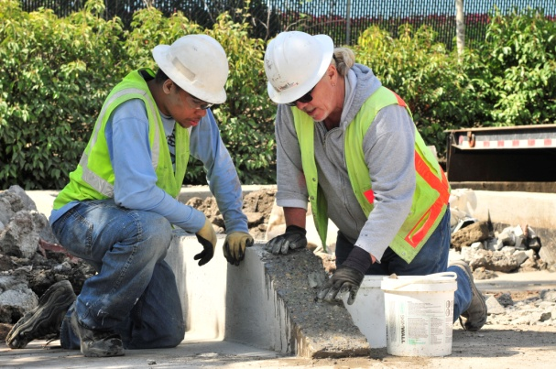
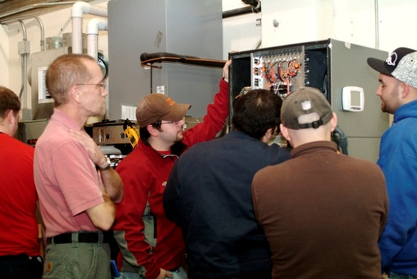
Major Training Initiatives
Apprenticeship / Crafts
AGC/CITT Programs (2,3 & 4-year)
Current Enrollment: 217
Graduates/Journey workers: 190
Brick Masons, Carpenters, Concrete Finishers, Heavy Equipment Operators, Laborers, Sign Hangers, Tile Setters/Finishers
ABC Programs (4-year)
Current Enrollment: 92
Graduates/Journeyworkers: xx
Sheet Metal Workers, HVAC Technicians

Slide 24
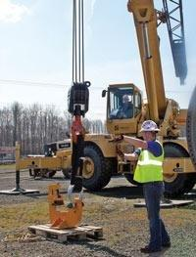
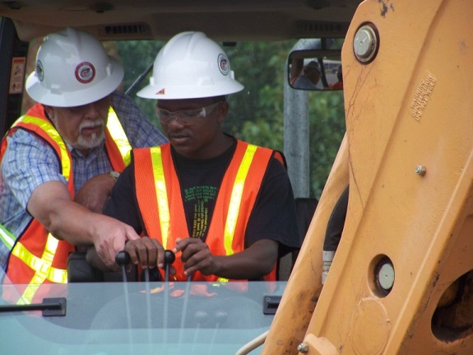
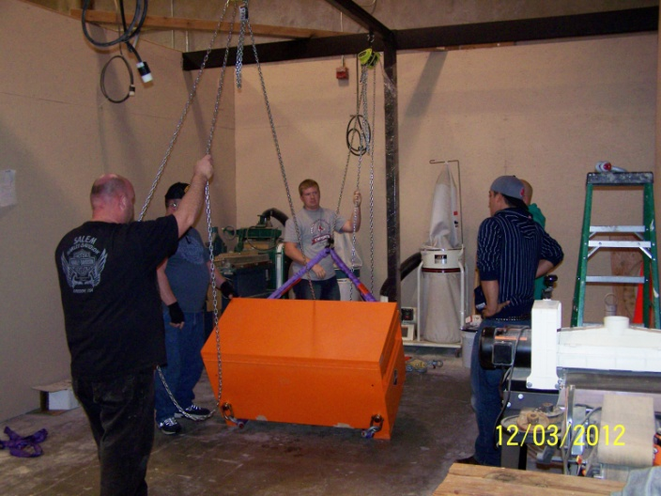
Major Training Initiatives
Craft Training-Other
Riggers: 32
Crane Operators: 36
Forklift Operators: 37
Brazing (HVAC Techs): 101

Slide 25
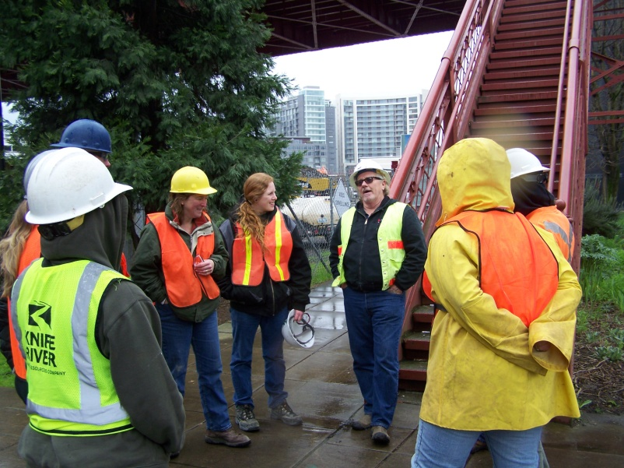
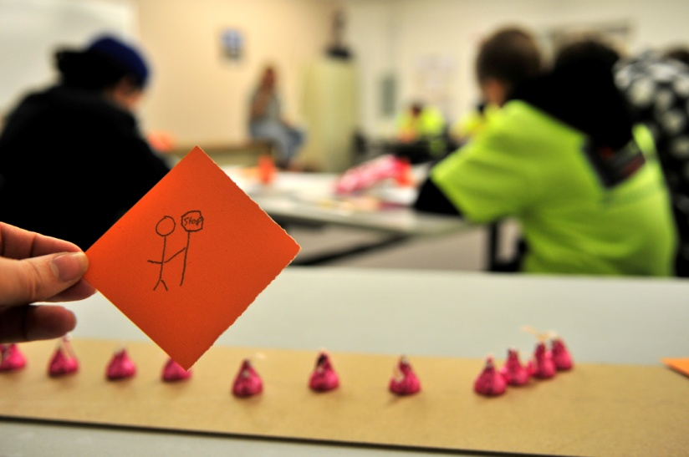
Major Training Initiatives
Safety
First Aid / CPR: 1082
Flagging: 671
OSHA 10: 1400
OSHA 30: 115
Confined Space: 142

Slide 26
Major Training Initiatives
Technical
Basic Computer Ops: 17
Excel: 10
MS Project: 7
Building Envelope: 76
Com’l Plan Reading: 61
Com’l Estimating: 26

Slide 27
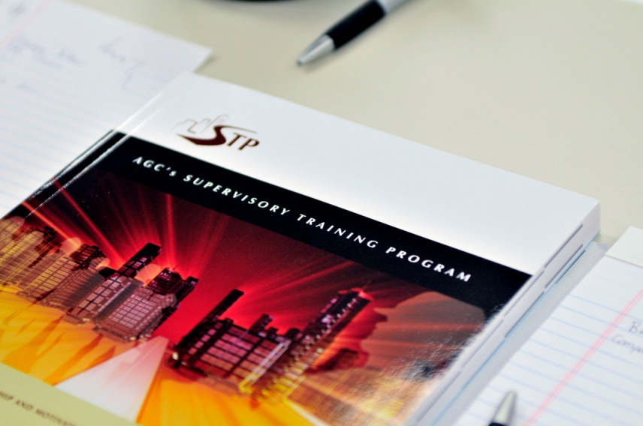
Major Training Initiatives
Supervisory/Management
Crew Leadership: 124
AGC STP: 1172
Project Management: 43
Customized Management Prgms: 35

Slide 28
Outreach Activities
Funding Organizations
AGC
CITT
Hamilton Construction
ODOT/BOLI
Epping Family Foundation
CITT

Slide 29
Outreach Partners & Participants
High School & Middle School
Career Fair Attendees
Constructing Hope
Youth Employment Institute
Oregon Tradeswomen
Grand Ronde Tribes
Siletz Tribes & Head Start
Work Systems Inc.
City of Portland Youth Programs

Slide 34
June 6, 2014 Board of Directors Meeting
New President
David Zagorodney
Agenda Item 8

Slide 35
June 6, 2014 Board of Directors Meeting
Investment Account Report
Andrew Carter, Morgan Stanley
Agenda Item 9

Slide 36
Oregon-Columbia Chapter AGC
Reserve Account Update
June 6, 2014

Slide 37
AGC Reserve Account Performance Comparison
as of May 30, 2014

Slide 52
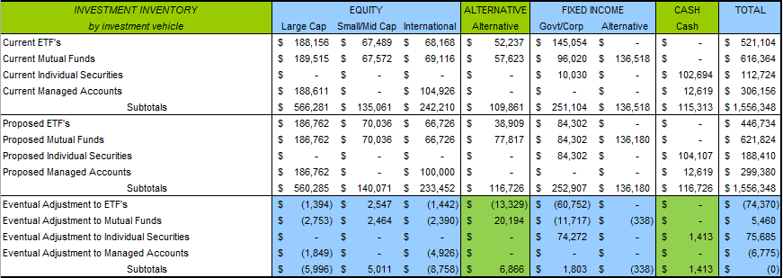

Slide 53
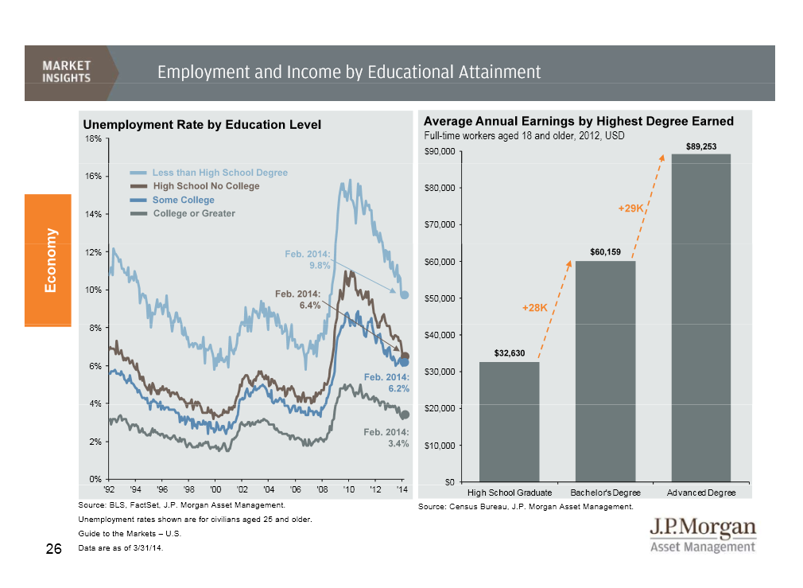

Slide 54
Oregon-Columbia Chapter AGC
Reserve Account Update
June 6, 2014

Slide 56
June 6, 2014 Board of Directors Meeting
Association Updates
SAIF Corporation Update
Construction Contractors Board Update
Agenda Item 10

Slide 57
June 6, 2014 Board of Directors Meeting
Events Update
Top Shot: June 20
Golf Tournament: July 11
AGCA Safety & Health Committee Meeting: July 16–18
Summer Convention: August 7–9
SIR Awards: November 1
Agenda Item 11

Slide 58
June 6, 2014 Board of Directors Meeting
SIR Award Recipients
Jack Markgraf Retired, Horizon Erectors
Jim McKune McKune, LLC
David Rogge, PhD Oregon State University Construction Engineering Management Professor
Scott Williams President, Hamilton Construction
Agenda Item 11

Slide 59
June 6, 2014 Board of Directors Meeting
Governance: Results of
Board Survey
Agenda Item 12

Slide 60
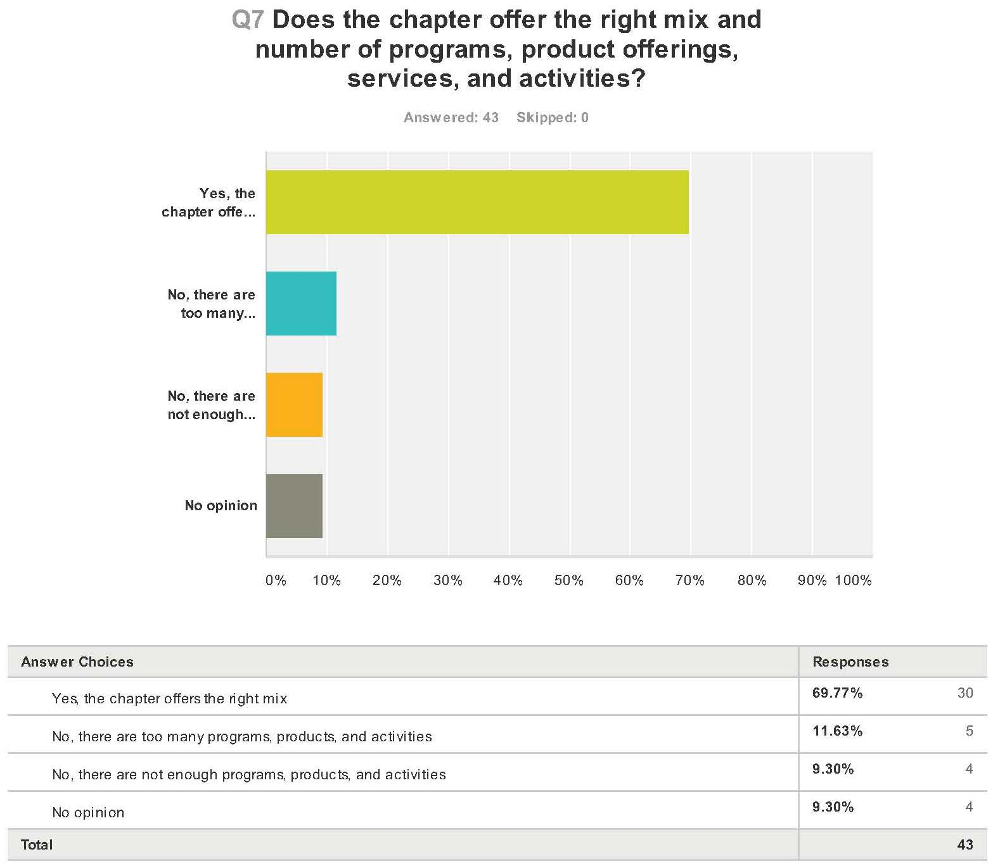

Slide 61
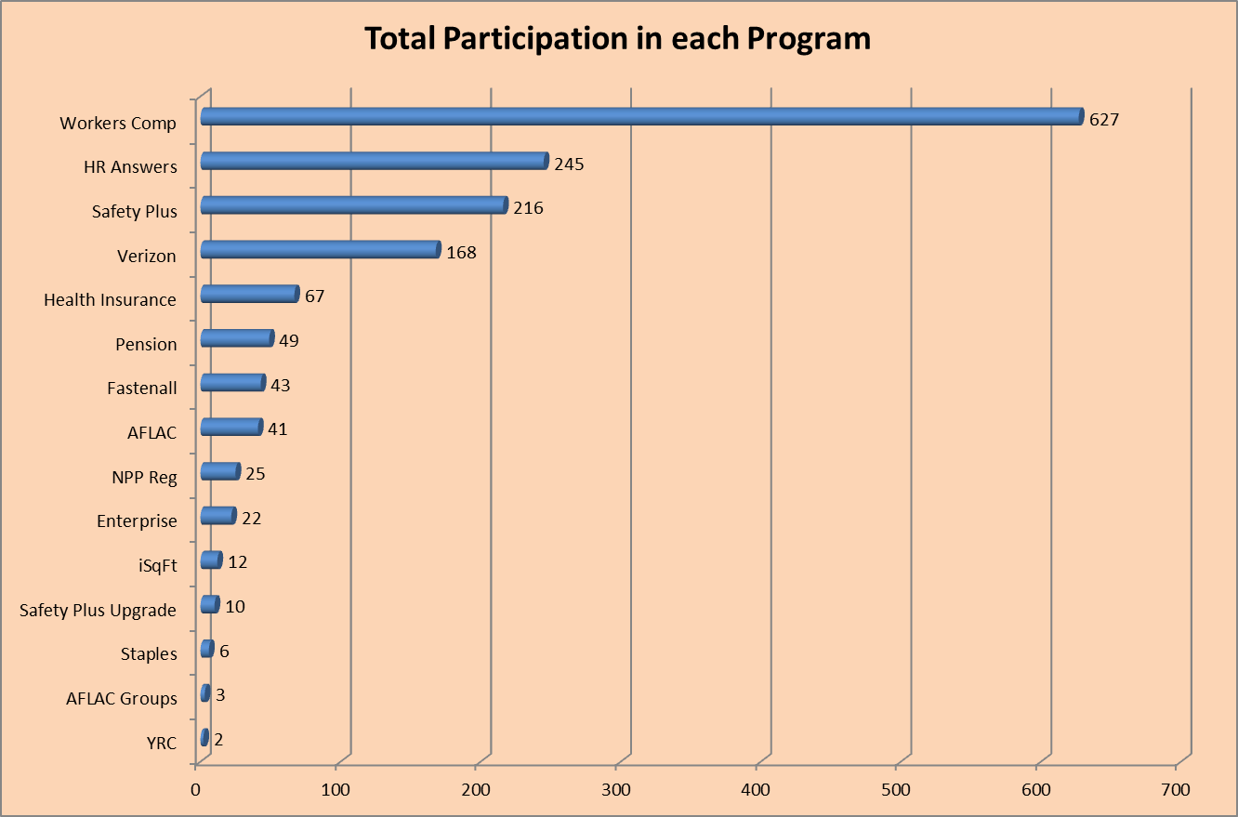
June 6, 2014 Board of Directors Meeting
Agenda Item 12

Slide 62
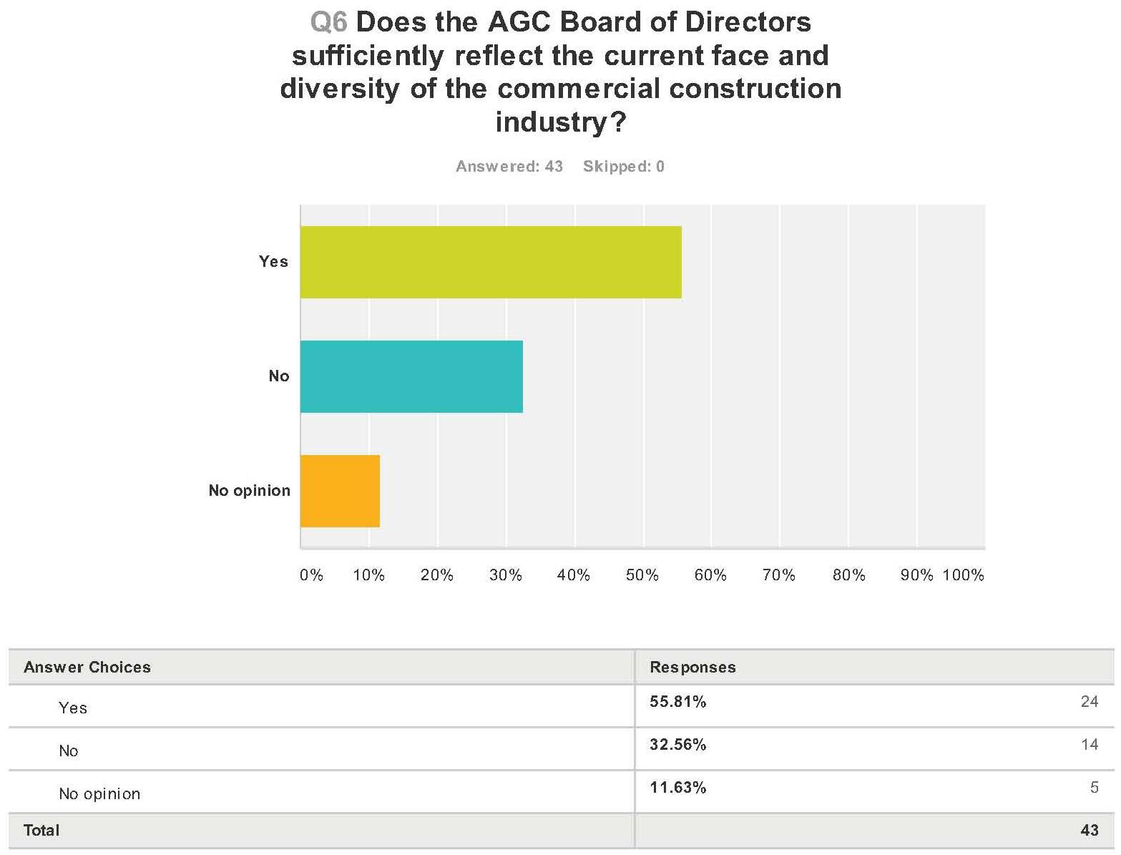

Slide 63
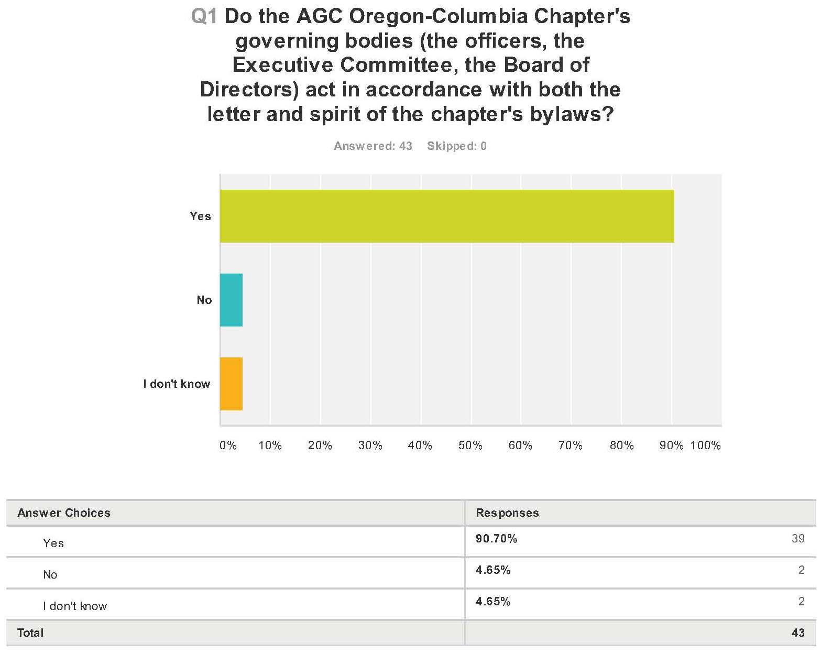

Slide 64
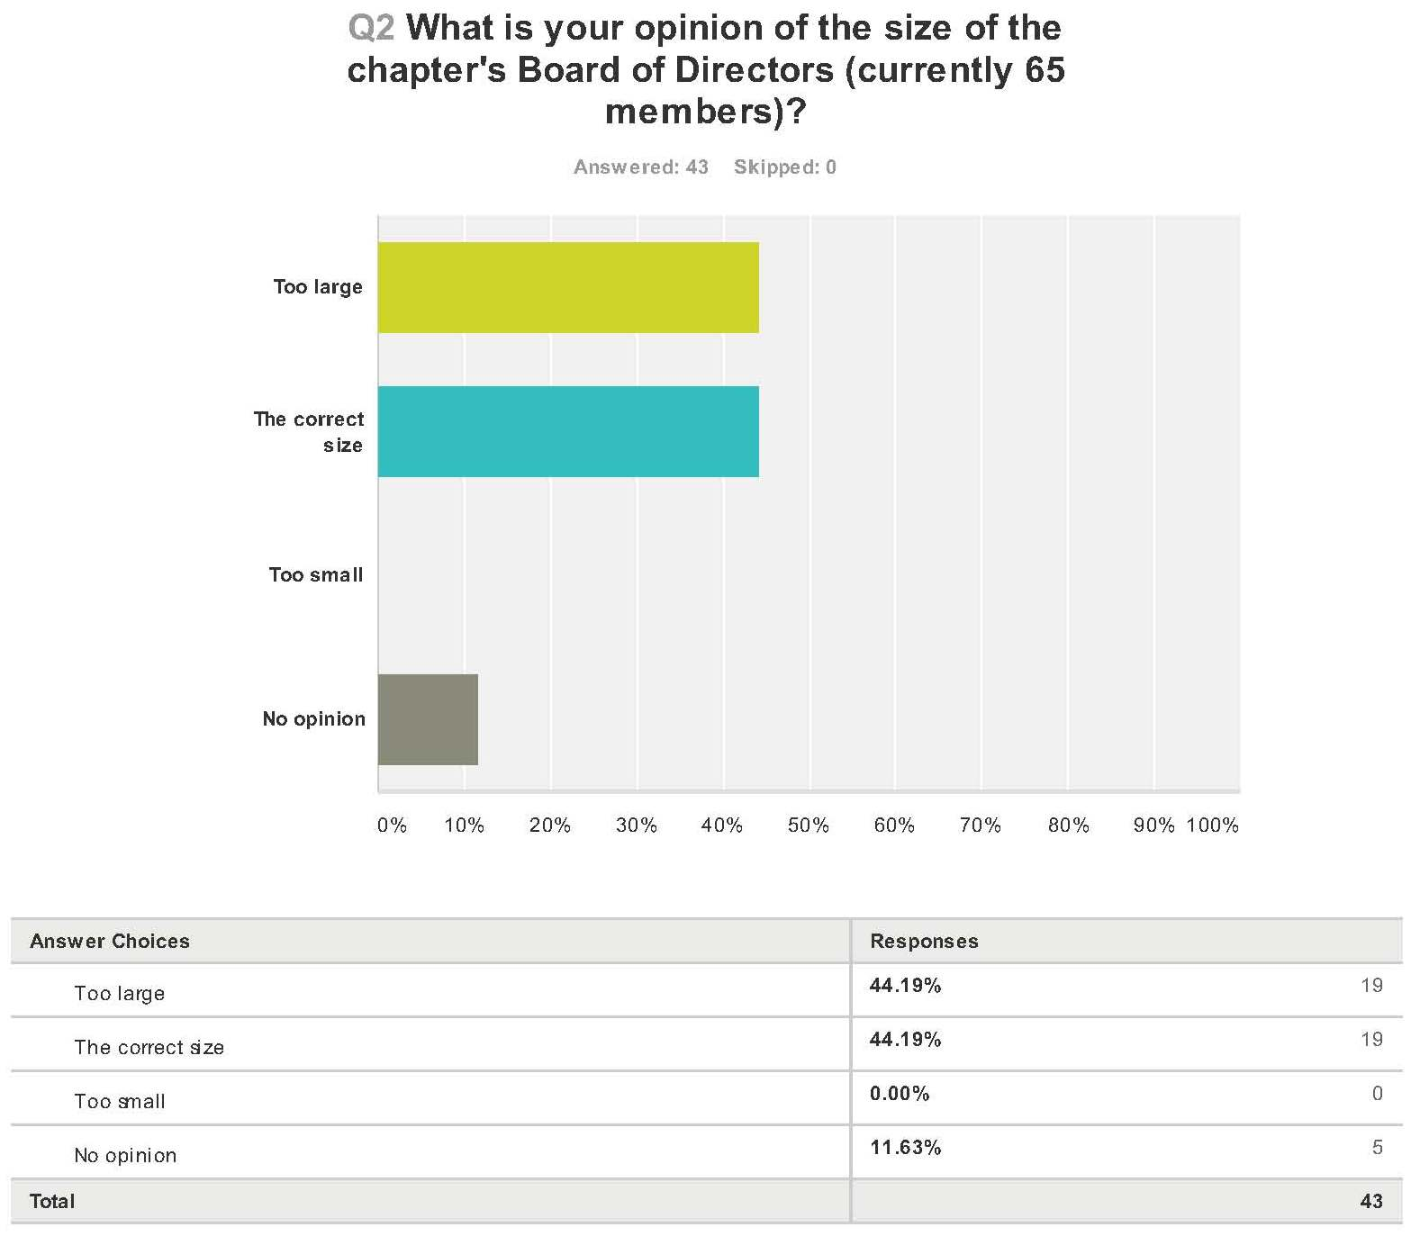

Slide 65
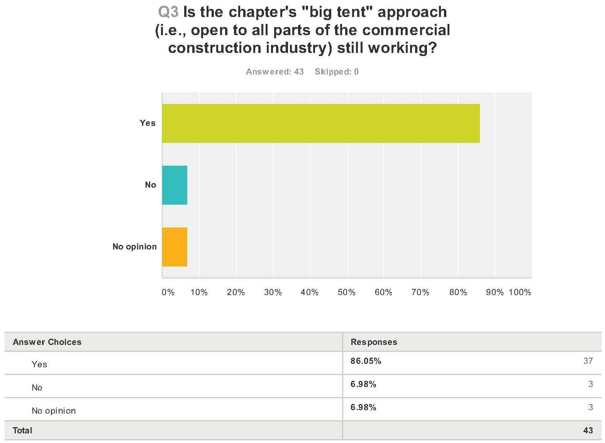

Slide 66
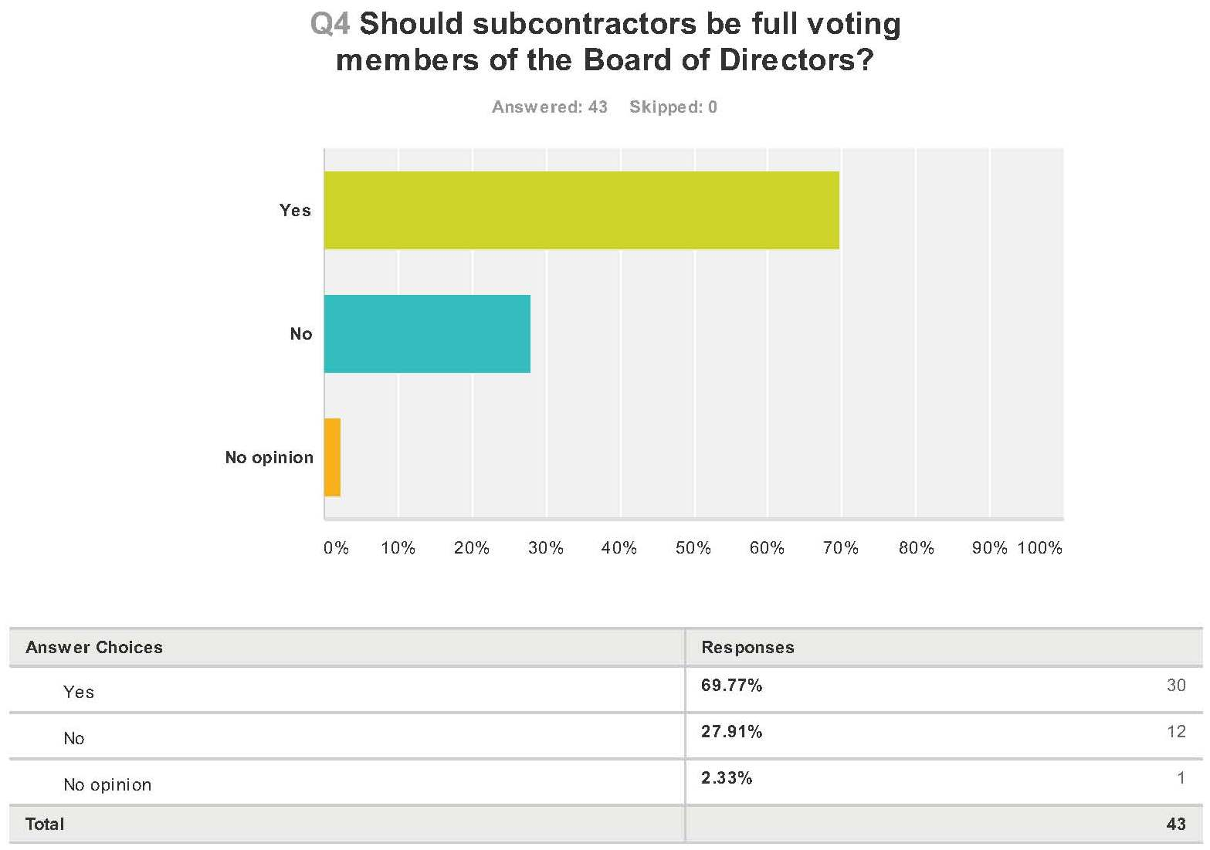

Slide 67
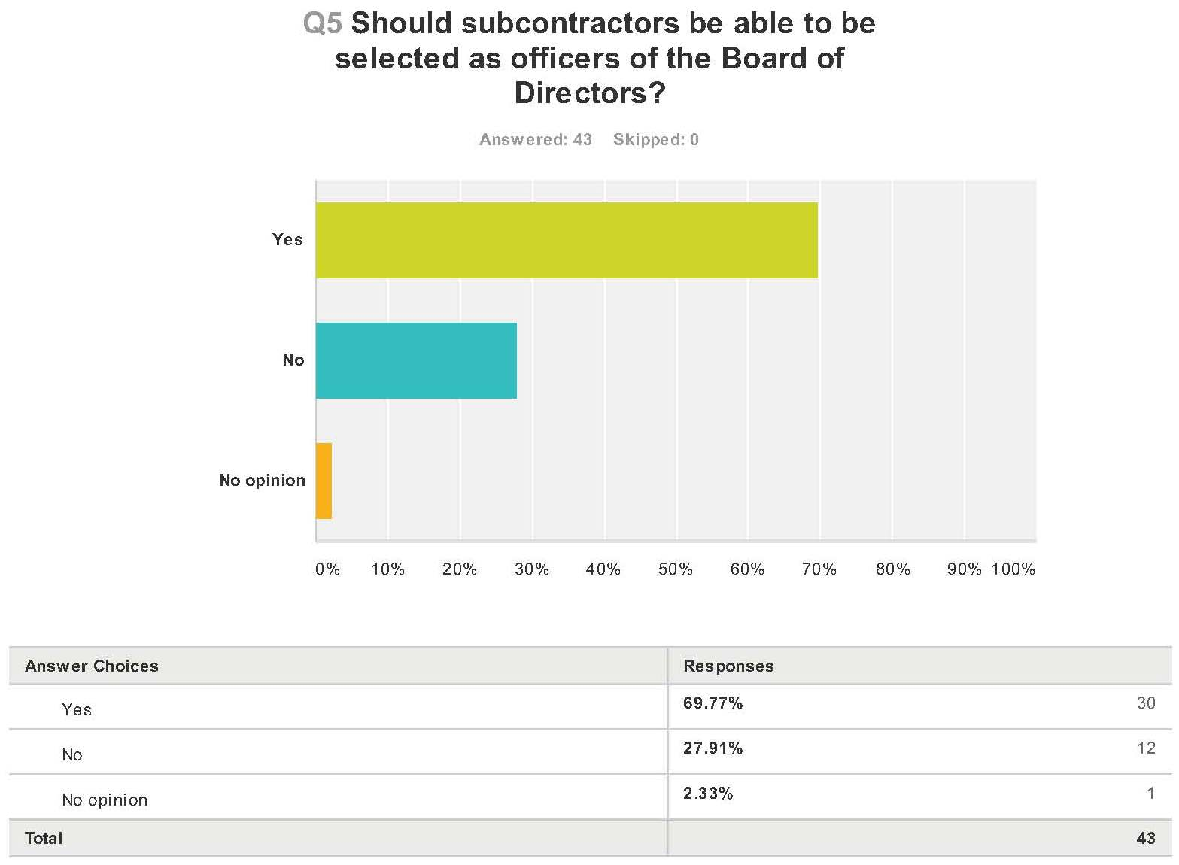

Slide 69
June 6, 2014 Board of Directors Meeting
Major Committee Updates
Legislative Committee Forum
Workforce and Professional Development Committee
Agenda Items 13–14

Slide 70
June 6, 2014 Board of Directors Meeting
Business Councils/Task Forces
Highway/Heavy/Utility Contractors Council
Professional & Industry Associates Council
Safety & Health Council
Agenda Items 15–19

Slide 71
June 6, 2014 Board of Directors Meeting
New Business
Agenda Item 20

Slide 72
June 6, 2014 Board of Directors Meeting
Next Meeting
Thursday, August 7
3–4:30 pm, Sunriver Resort

Slide 73
June 6, 2014 Board of Directors Meeting
Adjourn

